Slide 1
How to access KISTI Neuron system for AI Tutorial(da
Hyungon Ryu

Slide 2
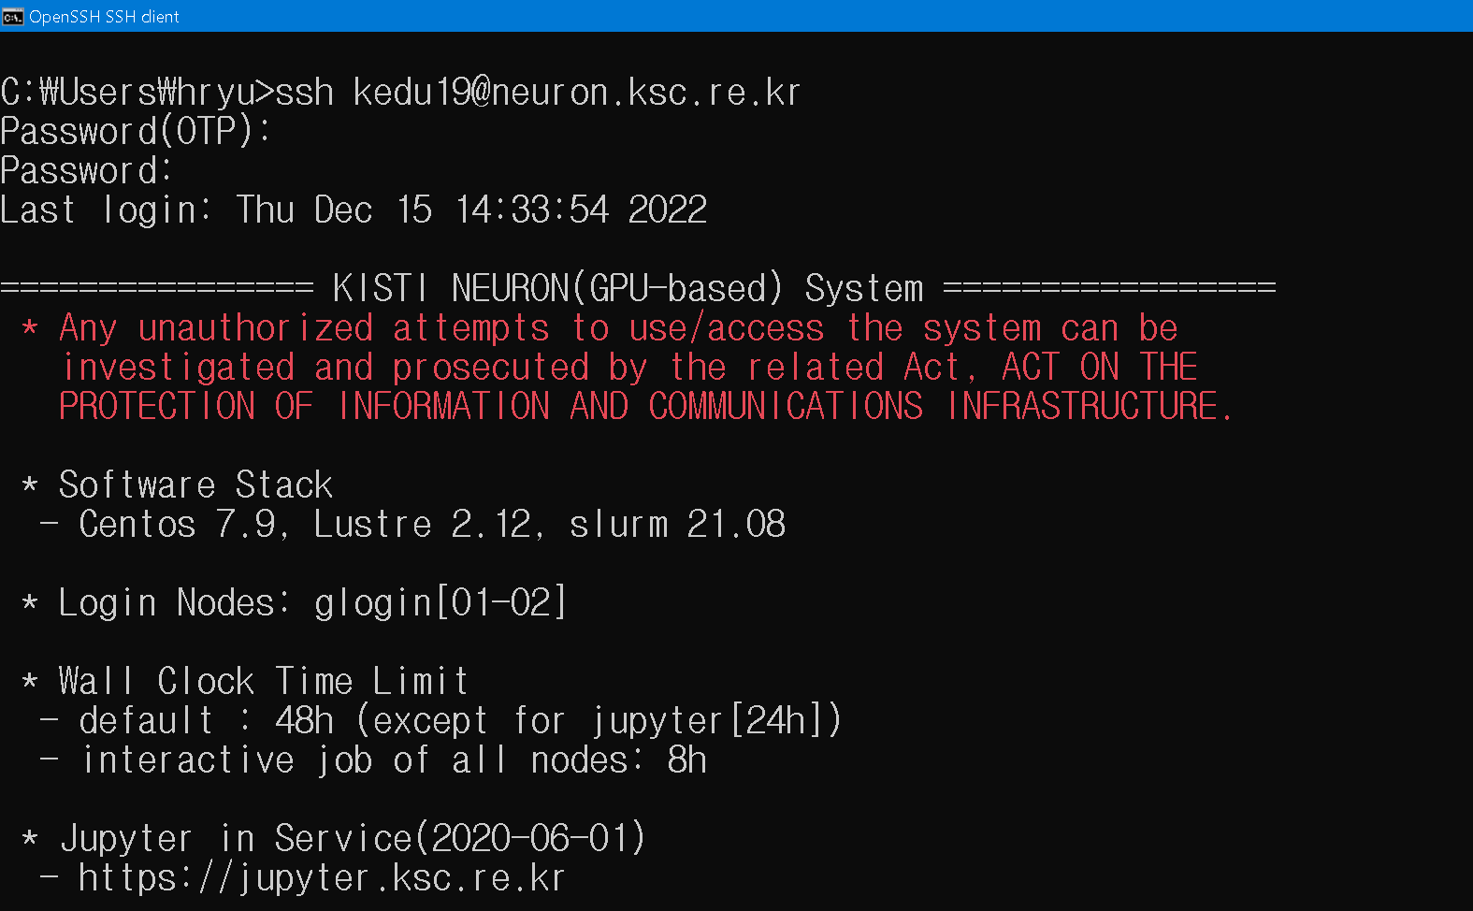
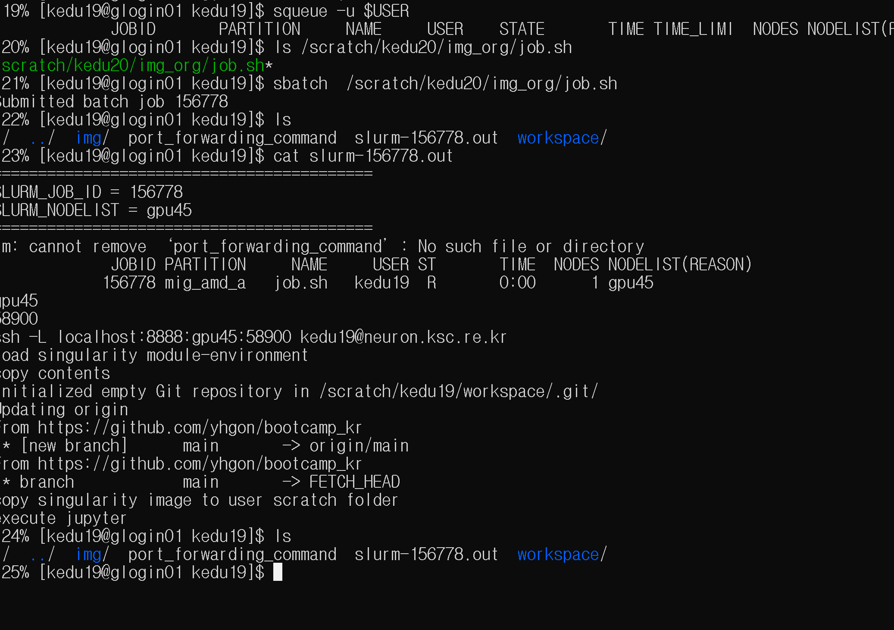
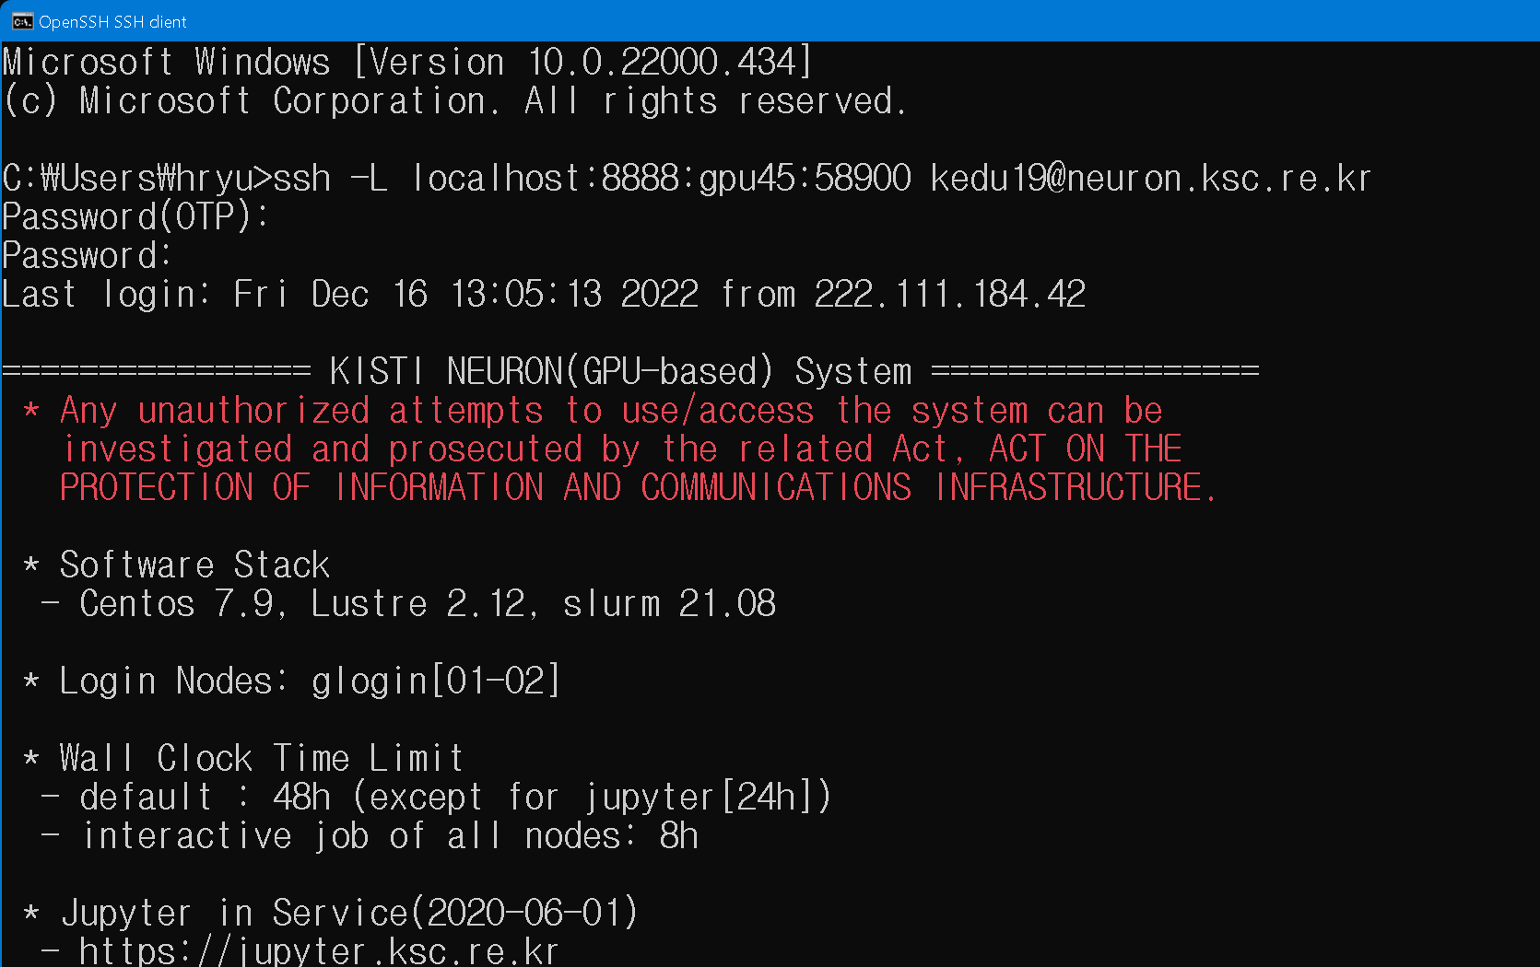
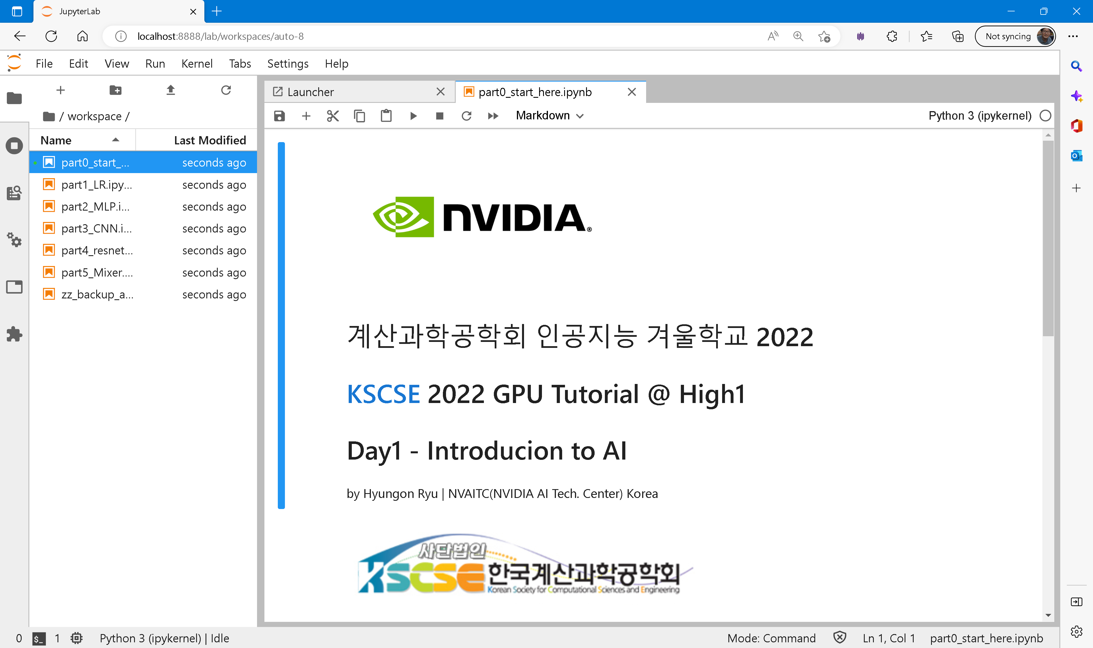
Overview for Day1
1
SSH Access to
KISTI Neuron
Login node
Allocate GPU node
and submit the job
Via slurm
3
Port Forwarding
For jupyter access
4
Open Web Browser
and Access Jupyter via web
2

Slide 3
Step1. Access Neuron
ssh kedu##@neuron.ksc.re.kr
ID : kedu01~45
Password(OTP) : 0633 (fixed value)
Password : wintai12^^ (fixed value)

Slide 4
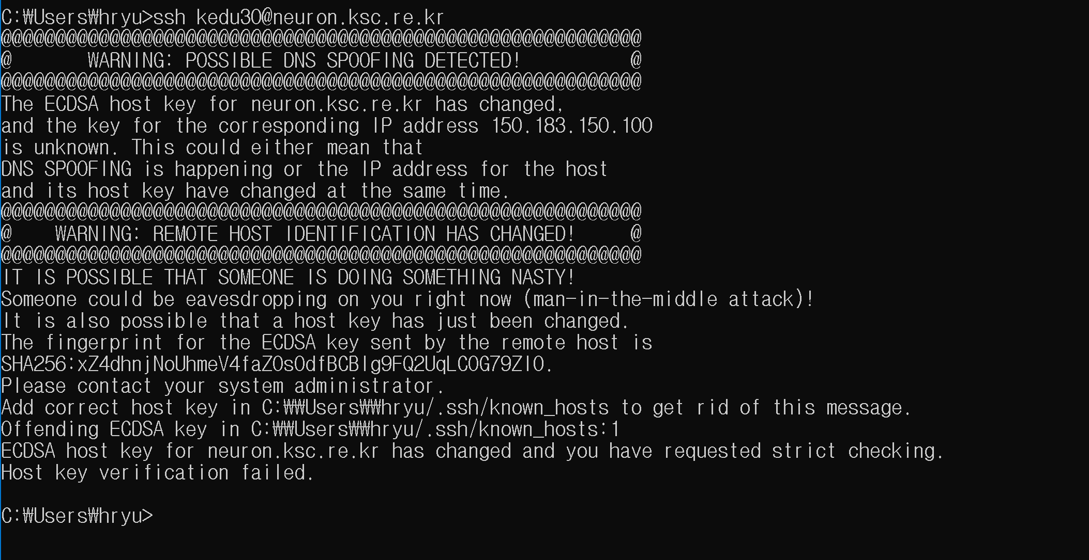
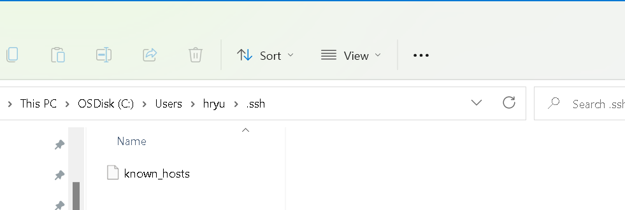
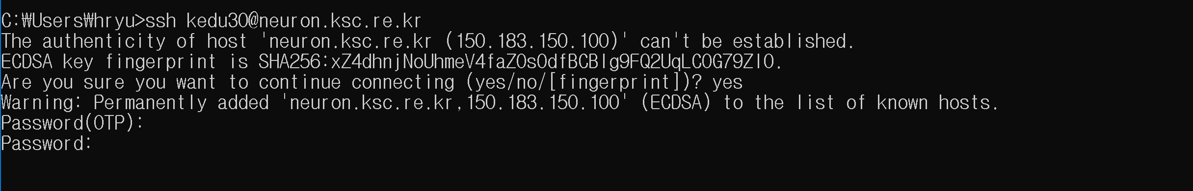
TIP : Trouble shooting
Problem :
Solution:
Delete neuron server in the lists or delete file
And retry
Solved :

Slide 5
Launch job
Check current slurm job
$ squeue –u $USER
Cancel all job if exist
$scancel –u $USER
Move to scratch direcoty
$ cd /scratch/$USER
Submit the job
$ sbatch /scratch/kedu49/img_org/job.sh

Slide 6
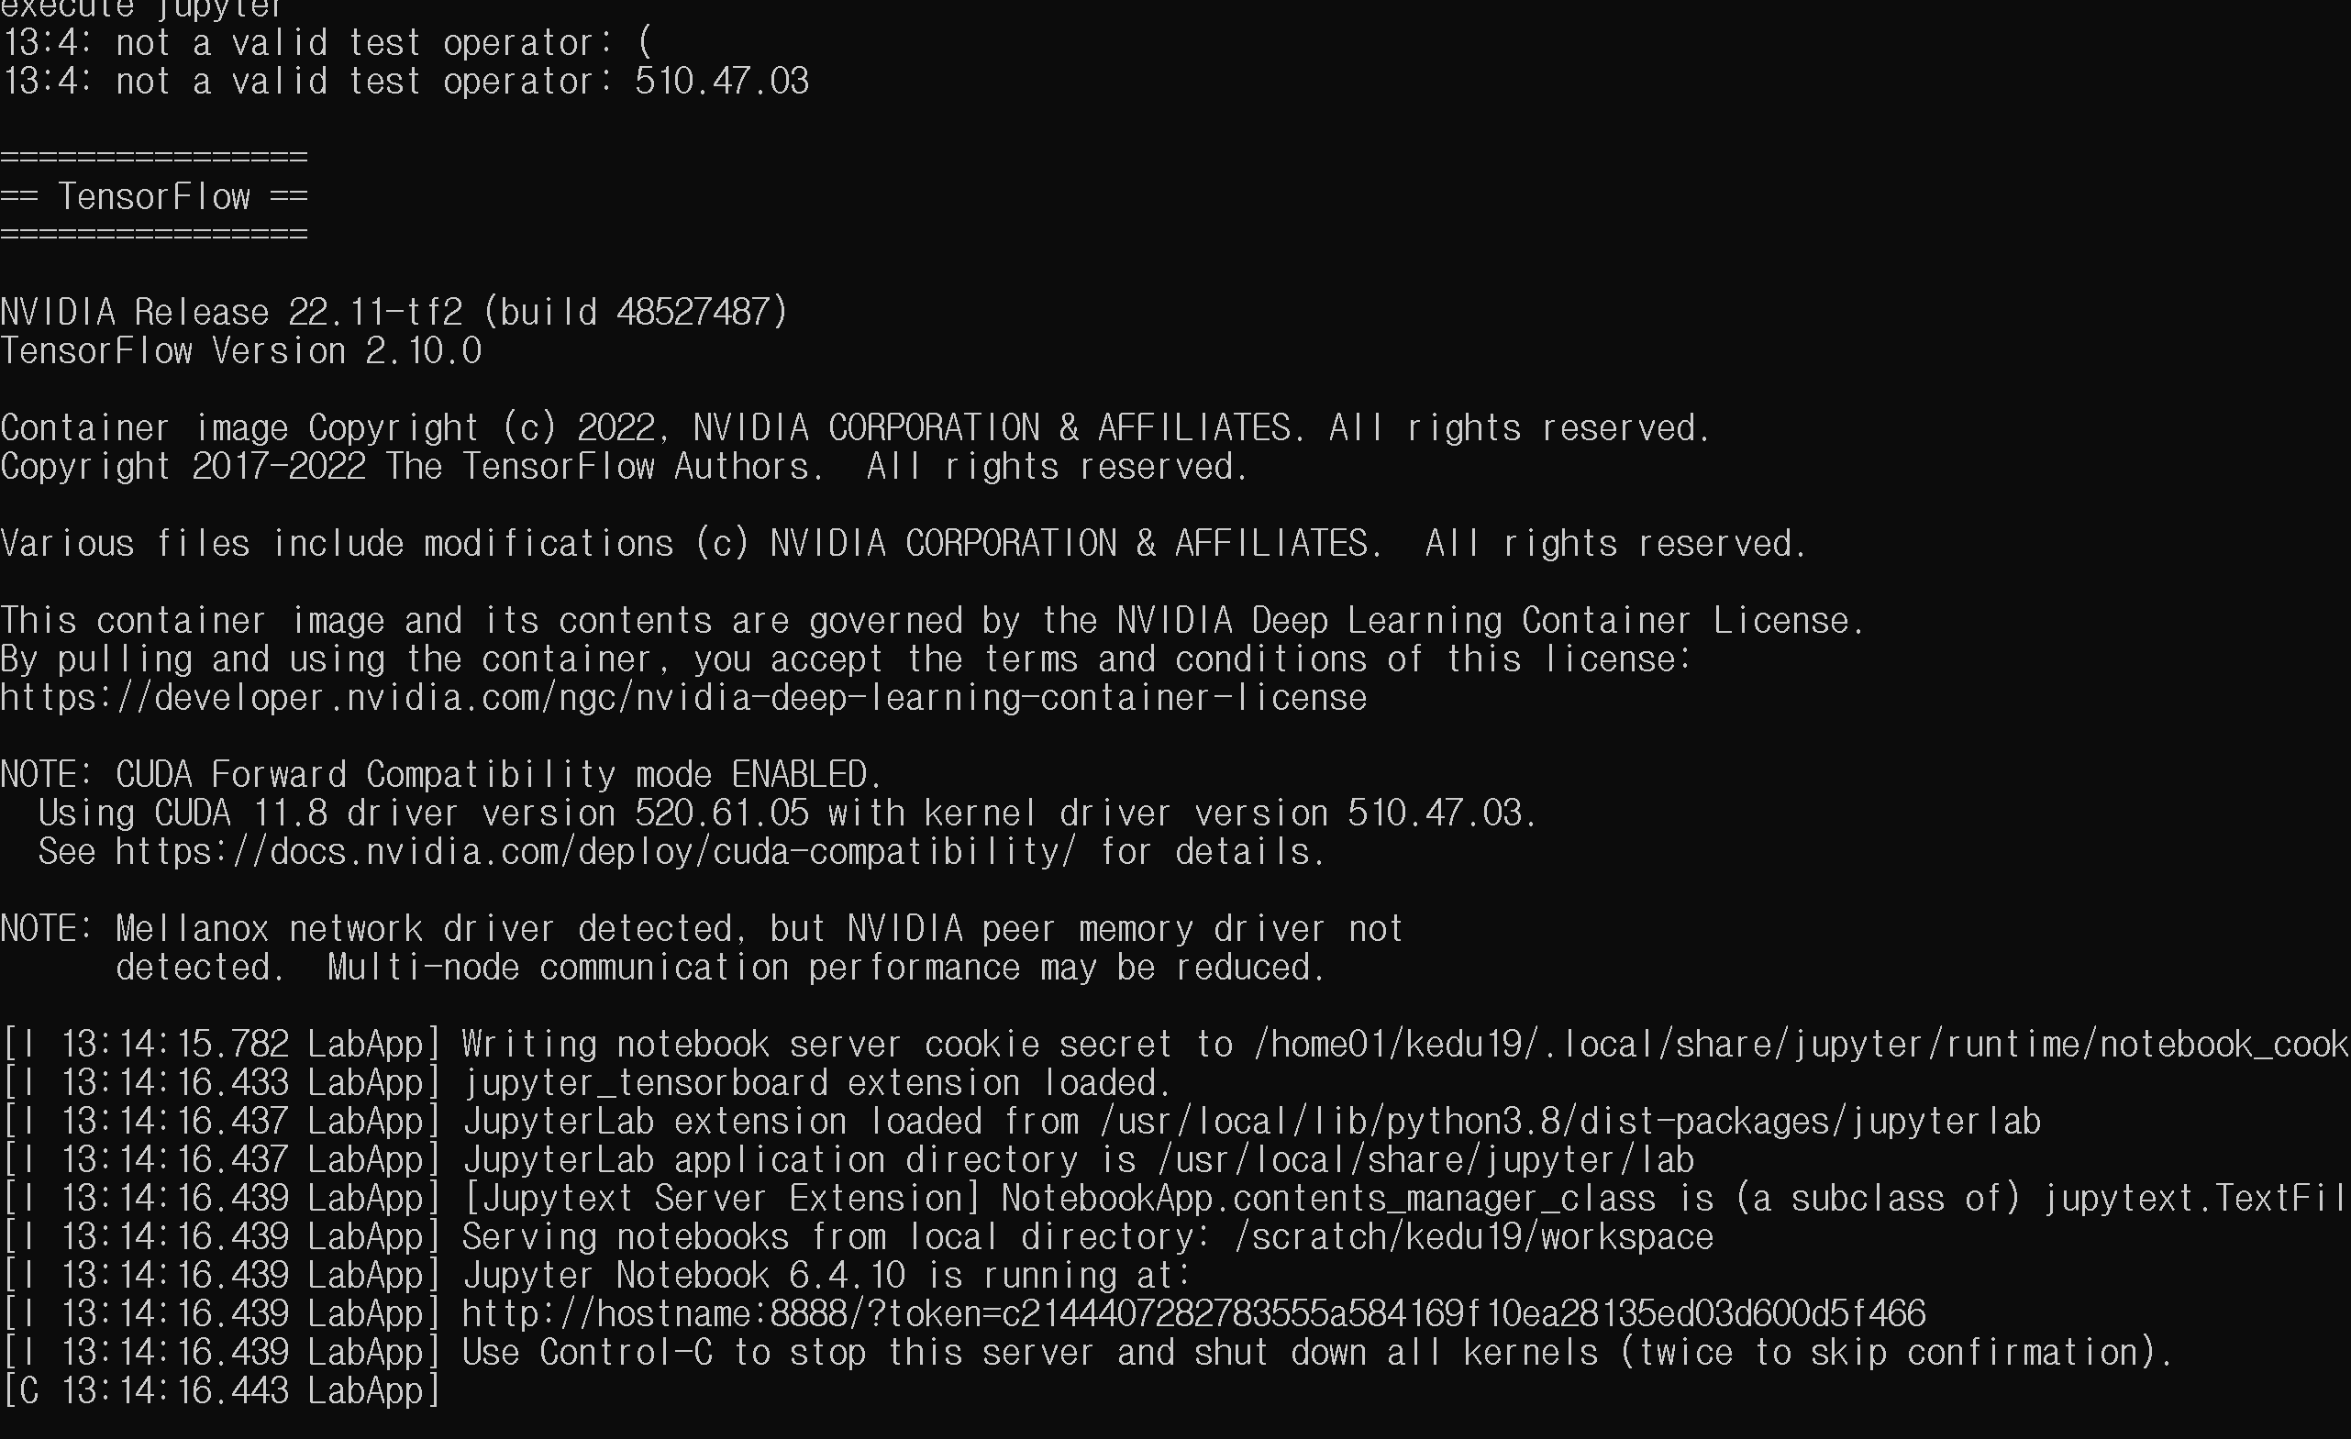
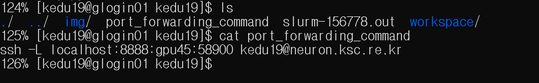
Check port number
Check the jupyter status in slurm log
$ cat slurm-jobid.out
Check the allocated port number
$ cat port_forwarding_command

Slide 7
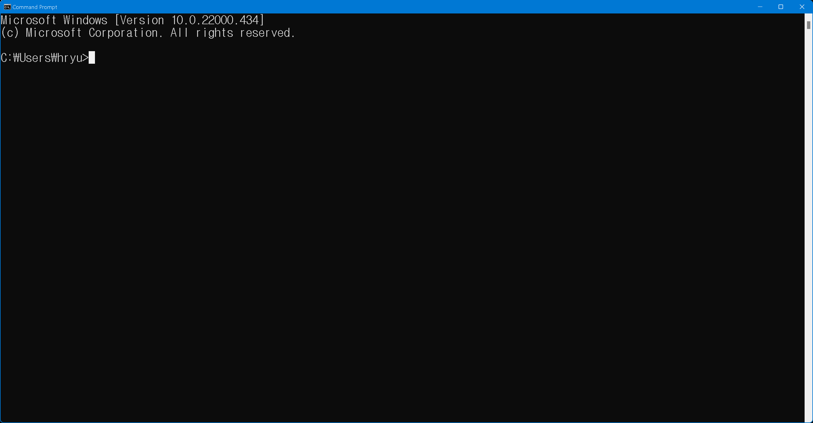
Open new terminal
New terminal !!!

Slide 8
Launch with port forwarding command
C:\>ssh -L localhost:8888:gpuXX:YYYYY kedu##@neuron.ksc.re.kr
Each number is dedicated to users
GPUXX : server number
YYYYY : port number
kedu## : user id

Slide 9
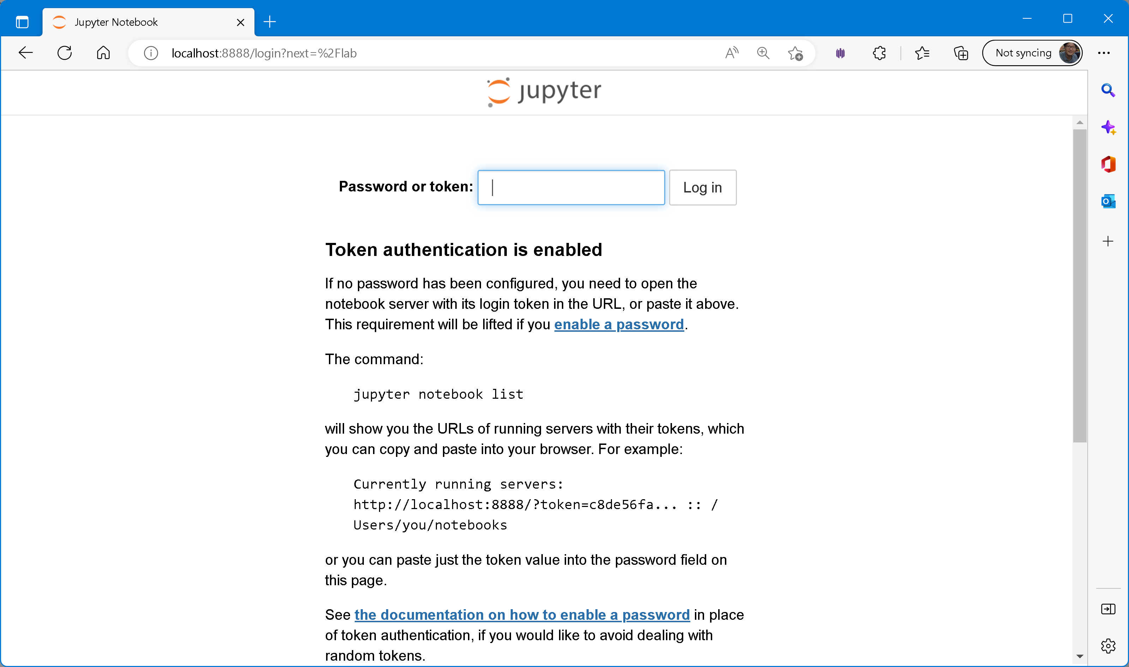
Open browser
Open Web browser and Access jupyter
URL : localhost:8888/lab
Password token : kedu##

Slide 10
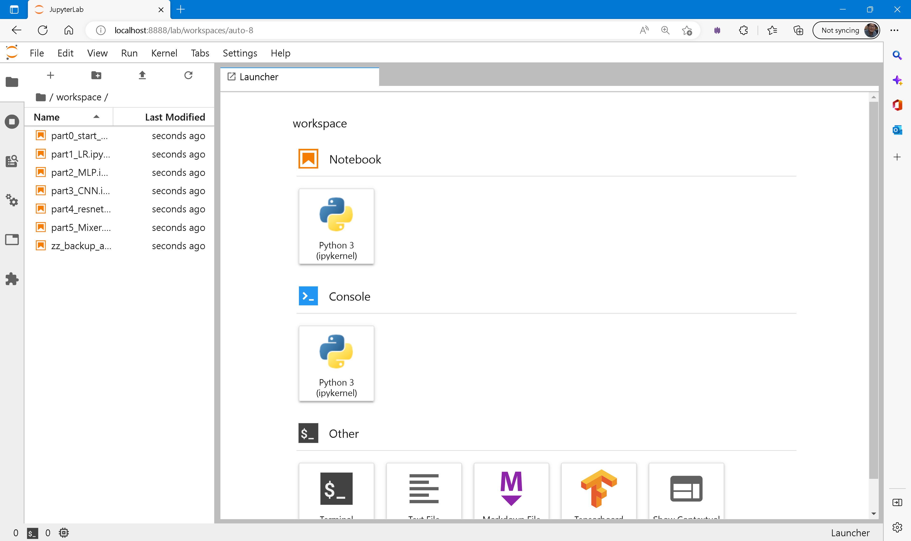
Select part0_start_here.ipynb notebook

Slide 11
Prepare jupyter

